Slide 1
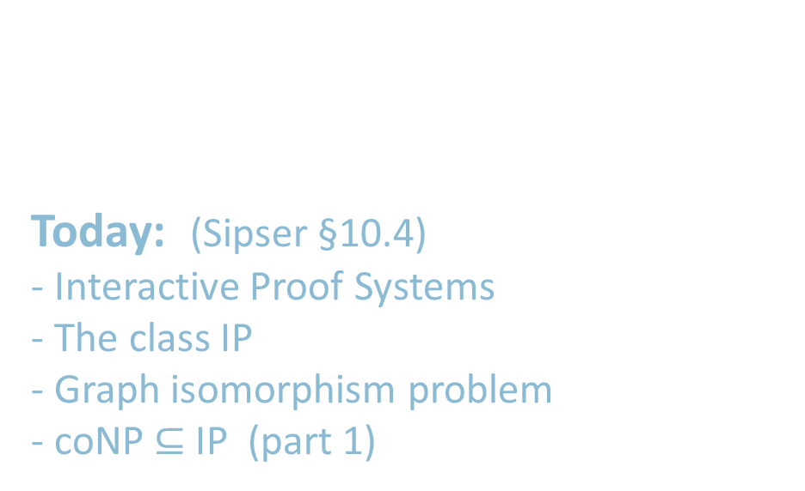
18.404/6.840 Lecture 25
Last time: - Schwartz-Zippel Theorem
- $EQ\text{ROBP}∈$ BPP
Today: (Sipser §10.4) - Interactive Proof Systems
- The class IP
- Graph isomorphism problem
- coNP $⊆$ IP (part 1)
1

Slide 2
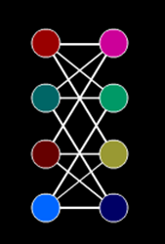
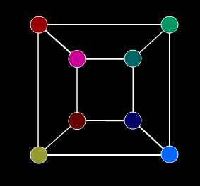

Interactive Proofs – Introduction
Illustration: Graph isomorphism testing
Defn: Undirected graphs $G$ and $H$ are isomorphic if they are identical except for a permutation (rearrangement) of the nodes.
2

Slide 3


Interactive Proofs – Introduction
Illustration: Graph isomorphism testing
Defn: Undirected graphs $G$ and $H$ are isomorphic if they are identical except for a permutation (rearrangement) of the nodes.
Defn: $ISO=\left\{〈G,H〉\right| G$ and $H$ are isomorphic graphs}
$ISO∈$ NP obvious
$ISO∈$ P ? unknown
$ISO$ is NP-complete ? unknown
$\overline{ISO}∈$ NP ? unknown
$ISO∈$ NP therefore a Prover can convince a poly-time Verifier that $G$ and $H$ are isomorphic (if true).
Even though $\overline{ISO}∈$ NP is unknown, a Prover can still convince a poly-time Verifier that $G$ and $H$ are not isomorphic (if true).
Requires interaction and a probabilistic Verifier.
3

Slide 4

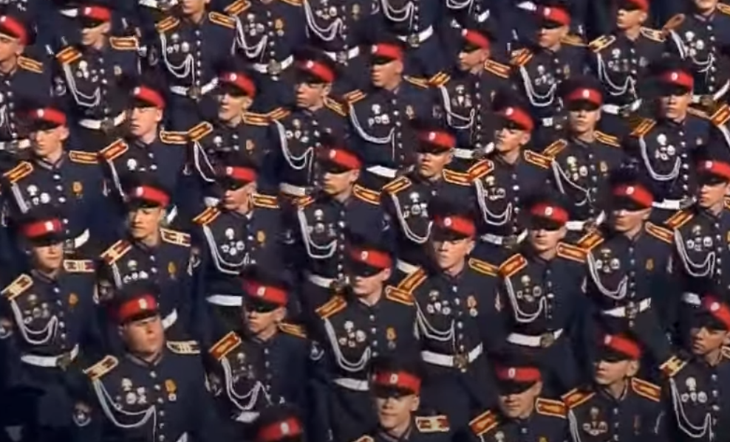




Interactive Proofs – informal model
$$G$$
$$H$$
Probabilistic polynomial time TM
© Sesame Workshop. All rights reserved. This content
is excluded from our Creative Commons license. For
more information, see https://ocw.mit.edu/fairuse.
Professor wants to know if graphs $G$ and $H$ are isomorphic.
- He asks his Students to figure out the answer.
- But he doesn’t trust their answer. He must be convinced.
Professor
= Verifier (V)
If the Students claim that $G$ and $H$ are isomorphic, they can give the isomorphism and convince him.
But what if they claim that $G$ and $H$ are not isomorphic?
- The Professor randomly and secretly picks $G$ or $H$ and permutes it, then sends the result to the Students.
- If Students can identify which graph the Professor picked reliably (repeat this 100 times), then he’s convinced.
Unlimited computation
Graduate Students
= Prover (P)
© Source unknown. All rights reserved. This content is excluded from our Creative Commons license. For more information, see https://ocw.mit.edu/fairuse.
4

Slide 5


Interactive Proofs – formal model
Two interacting parties
Verifier (V): Probabilistic polynomial time TM
Prover (P): Unlimited computational power
Both P and V see input $w$.
They exchange a polynomial number of polynomial-size messages.
Then V accepts or rejects.
Defn: Pr[ (V$↔\text{P}$) accepts $w$ ] = probability that V accepts when V interacts with P, given input $w$.
Defn: IP $=\left\{A\right|$ for some V and P (This P is an “honest” prover)
$w∈A →$Pr [ (V $↔$ P) accepts $w$ ] $≥2/3$
$w∉A →$for any prover $\tilde{\text{P}}$ Pr [ (V $↔$ $\tilde{\text{P}}$) accepts $w$ ] $≤1/3$
Think of $\tilde{\text{P}}$ as a “crooked” prover trying to make V accept when it shouldn’t.
An amplification lemma can improve the error probability from $1/3$ to $1/{2^{poly \left(n\right)}}$
5

Slide 6


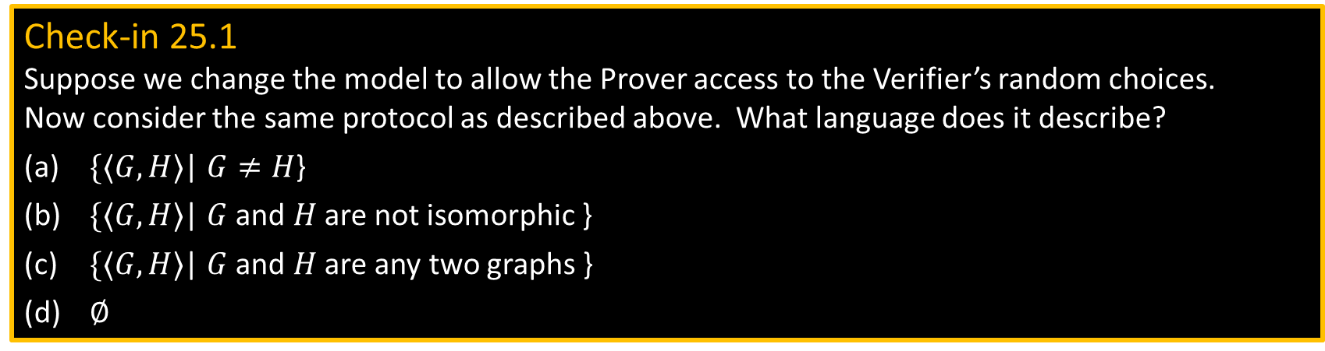

$\overline{ISO}∈$IP
Theorem: $\overline{ISO}∈$ IP
Proof: Protocol for V and (the honest) P on input $〈G,H〉$
1) Repeat twice:
2) V$→$P Randomly choose $G$ or $H$ and permute to get $K$, then send $K$
3) P$→$V Compare $K$with $G$ and $H$. Send “$G$” or “$H$” (V’s choice in step 2)
4) V accepts if P was correct both times. Otherwise V rejects.
Check-in 25.1
Suppose we change the model to allow the Prover access to the Verifier’s random choices. Now consider the same protocol as described above. What language does it describe?
$\{〈G,H〉$| $G≠H$}
$\{〈G,H〉$| $G$ and $H$ are not isomorphic }
$\{〈G,H〉$| $G$ and $H$ are any two graphs }
$∅$
If $G$ and $H$ are not isomorphic then P can determine which graph V chose randomly.
Thus Pr [ ($\text{V}↔$ P) accepts $〈G,H〉$ ] $=1≥2/3$
If $G$ and $H$ are isomorphic then any $\tilde{\text{P}}$ has no way to tell which graph V chose randomly.
So $\tilde{\text{P}}$ has a 50% chance of answering correctly each time and a 25% chance of being correct twice.
Thus Pr [ (V $↔$ $\tilde{\text{P}}$) accepts $〈G,H〉$ ] $=1/4<1/3$.
6
Check-in 25.1

Slide 7


Facts about IP – Checkin 25.2
Which of the following is true? Check all that apply
NP $⊆$ IP [ V is deterministic ]
BPP $⊆$ IP [ V ignores P ]
IP $⊆$ PSPACE [ We won’t prove. Idea: explore all possible interactions in poly space. ]
Surprising Theorem: PSPACE $⊆$ IP so IP = PSPACE
We will prove only a weaker statement: coNP $⊆$ IP
7

Slide 8



$\#SAT$ problem
Defn: $\#SAT=\left\{〈φ,k〉\right|$Boolean formula $φ$has exactly $k$ satisfying assignments$\}$
Let $\#φ=$the number of satisfying assignments of Boolean formula $φ$.
So $\#SAT=\left\{〈φ,k〉\right| k=\#φ\}$
Defn: Language $B$ is NP-hard if $A≤_{P}B$ for every $A∈$ NP.
(Note: $B$ is NP-complete if $B$ is NP-hard and $B∈$ NP.)
Theorem: $\#SAT$ is coNP-hard
Proof: Show $\overline{SAT}≤_{P}\#SAT$
$f\left(〈φ〉\right)=⟨φ,0⟩$
To show coNP $⊆$ IP we will show $\#SAT∈$ IP
8

Slide 9

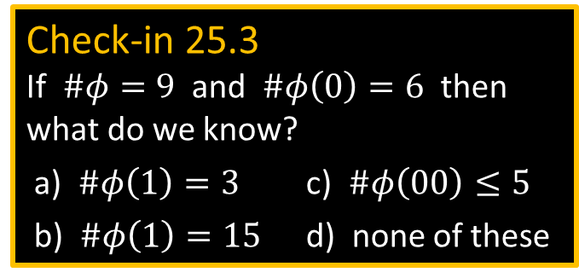




$\#SAT∈$ IP – notation
$\#SAT=\left\{〈φ,k〉\right|$Boolean formula $φ$has exactly $k$ satisfying assignments$\}$
Theorem: $\#SAT∈$ IP
Proof: First some notation. Assume $φ$ has $m$ variables $x_{1},…, x_{m}$.
Let $φ(0)$ be $φ$ with $x_{1}=0$ (0 substituted for $x_{1}$) 0 = False and 1 = True.
Let $φ\left(01\right)$ be $φ$ with $x_{1}=0$ and $x_{2}=1$.
Let $φ(a_{1}…a_{i})$ be $φ$ with $x_{1}=a_{1}$ , … , $x_{i}=a_{i}$ for $a_{1},…, a_{i}∈\left\{0,1\right\}$.
Call $a_{1},…, a_{i}$ presets. The remaining $x_{i+1}, …, x_{m}$ stay as unset variables.
Let $\#φ$ = the number of satisfying assignments of $φ$.
Let $\#φ\left(0\right)$ = the number of satisfying assignments of $φ\left(0\right)$.
Let $\#φ(a_{1}…a_{i})$ = the number of satisfying assignments of $φ(a_{1}… a_{i})$
Equivalently:
Check-in 25.3
If $\#φ=9$ and $\#φ\left(0\right)=6$ then what do we know?
a) $\#φ\left(1\right)=3$ c) $\#φ\left(00\right)≤5$
b) $\#φ\left(1\right)=15$ d) none of these
Two useful facts
$$\#φ(a_{1}… a_{i})=\sum{φ(a_{1}… a_{m})}$$
1. $\#φ(a_{1}…a_{i})=$ $$\#φ\left(a_{1}…a_{i}0\right)+\#φ\left(a_{1}…a_{i}1\right)$$
2. $\#φ(a_{1}…a_{m})=$ $φ(a_{1}… a_{m})$
$$a_{i+1},…, a_{m}$$ $∈\left\{0,1\right\}$
9
Check-in 25.3

Slide 10



























$\#SAT∈$ IP – 1st attempt
Theorem: $\#SAT∈$ IP
Proof: Protocol for V and (the honest) P on input $〈φ,k〉$
0) P sends $\#φ$; V checks $k=\#φ$
1) P sends $\#φ\left(0\right)$, $\#φ\left(1\right)$; V checks $\#φ=\#φ\left(0\right)+\#φ\left(1\right)$
2) P sends $\#φ\left(00\right)$, $\#φ\left(01\right)$, $\#φ\left(10\right)$, $\#φ\left(11\right)$; V checks $\#φ\left(0\right)=\#φ\left(00\right)+\#φ\left(01\right)$
$\#φ\left(1\right)=\#φ\left(10\right)+\#φ\left(11\right)$
$⋮$
$m$) P sends $\#φ\left(0⋯0\right)$, … , $\#φ\left(1⋯1\right)$; V checks $\#φ\left(0⋯0\right)=\#φ\left(0⋯00\right)+\#φ\left(0⋯01\right)$
$⋮$
V checks $\#φ\left(1⋯1\right)=\#φ\left(1⋯10\right)+\#φ\left(1⋯11\right)$
$m+1$) V checks $\#φ\left(0⋯0\right)=φ\left(0⋯0\right)$
$⋮$
$\#φ\left(1⋯1\right)=φ\left(1⋯1\right)$
V accepts if all checks are correct. Otherwise V rejects.
$$k$$
If $k≠\#φ$
$$m$$
$$m−1$$
$$m−1$$
=
$$\#φ$$
$$\#φ$$
+
$$\#φ\left(0\right)$$
$$\#φ\left(1\right)$$
$$m$$
$$\#φ\left(1\right)$$
+
+
$$\#φ\left(00\right)$$
$$\#φ\left(01\right)$$
$$\#φ\left(10\right)$$
$$\#φ\left(10\right)$$
$$\#φ\left(11\right)$$
$$⋮$$
$$⋮$$
$$⋮$$
$$\#φ\left(0⋯0\right)$$
$$⋯$$
$$\#φ\left(1⋯1\right)$$
=
≠
=
Problem: Exponential. How to fix?
$$φ\left(0⋯0\right)$$
$$⋯$$
$$φ\left(1⋯1\right)$$
10

Slide 11

























Idea for fixing $\#SAT∈$ IP protocol
$$k$$
$$k$$
=
=
$$\#φ$$
$$\#φ$$
+
$$\#φ\left(0\right)$$
$$\#φ\left(1\right)$$
$$\#φ\left(r_{1}\right)$$
+
+
Non-Boolean assignments to the variables of $φ$
$$\#φ\left(00\right)$$
$$\#φ\left(01\right)$$
$$\#φ\left(10\right)$$
$$\#φ\left(11\right)$$
$$\#φ\left(r_{1}r_{2}\right)$$
+
+
+
+
To be continued…
$$⋮$$
$$⋮$$
$$⋮$$
$$\#φ\left(0⋯0\right)$$
$$⋯$$
$$\#φ\left(1⋯1\right)$$
$$\#φ\left(r_{1}⋯r_{m}\right)$$
=
=
=
$$φ\left(0⋯0\right)$$
$$⋯$$
$$φ\left(1⋯1\right)$$
$$φ\left(r_{1}⋯r_{m}\right)$$
11

Slide 12

Quick review of today
Introduced the interactive proof system model
Defined the class IP
Showed $\overline{ISO}∈$ IP
Started showing $\#SAT∈$ IP to prove that coNP $⊆$ IP
12

Slide 13
MIT OpenCourseWare
https://ocw.mit.edu
18.404J Theory of Computation
Fall 2020
For information about citing these materials or our Terms of Use, visit: https://ocw.mit.edu/terms.

